Slide 1

Preparing for Retirement:
UC Retiree Health Insurance
Presenter: Rebecca Preza
Health Care Facilitator, UCSB
05/2020

Slide 2
This presentation is intended for communication purposes only, it is not a guarantee of benefits.
Details about the UC policies and health plans are available on UCnet.
  http://ucnet.universityofcalifornia.edu/compensation-and-benefits/index.html

Slide 3
Topics
Emeritus & Retiree Associations
Eligibility
FAQs
Plan Options
Cost of Retiree Health Insurance
Medicare & UC plans
Resources

Slide 4

Emeriti & Retiree Associations
Karen Rasmussen- Emeriti & Retiree Coordinator
Karen.Rasmussen@hr.ucsb.edu
Learn More:
Events
Newsletters
Welcome Letter
Retiree ID card
List of privileges
Membership application
http://www.hr.ucsb.edu/retirees

Slide 5

POSTPONED!
RSVP by May 13th at Karen.Rasmussen@hr.ucsb.edu or x2168

Slide 6
If you have questions…
RASC- 1-800-888-8267
Submit inquiries via UCRAYS secure email
retirementatyourservice.ucop.edu
-“Getting Help with UCRAYS” on UCnet
UCSB Health Care Facilitator Program
Rebecca.Preza@hr.ucsb.edu

Slide 7

Future of Retiree Health
UC is committed to ongoing health benefits
Not a guaranteed benefit
Plan designs can change
Your share of costs may increase year over year

Slide 8

Eligibility

Slide 9
Eligibility for Health Benefits
Enrolled or eligible to be enrolled in UC employee health coverage at retirement
Elect a monthly retirement income.
10 or more years of UCRP service credit for medical and dental
Elect to continue coverage or suspend at the time of retirement

Slide 10
Eligibility for Health Benefits cont’d
Have a Retirement date that is within 120 days from the date you leave UC employment
Continue coverage until the date your retirement income begins
If you select “lump sum cashout” you forfeit eligibility for retiree health benefits.

Slide 11
Retiree Health Insurance Eligibility
Three retiree health insurance groups with different University of California Retirement Plan (UCRP) entry dates
Group 1
Entry prior to 1/1/1990
Group 2
Entry or reentry on or after 1/1/1990 to 6/30/2013
Group 3
Entry or reentry on or after 7/1/2013

Slide 12

FAQs

Slide 13

Who can answer retirement questions?
The Retirement Administration Service Center (RASC).
Must submit your inquires to RASC via your UCRAYS secure email. RASC can assist with retirement eligibility questions, elections, transition to retiree health, retiree health costs, and Medicare.
1-800-888-8267

Slide 14


When does retiree insurance start?
Separate in June
then UCSB plan
ends July 31
UC retiree plan
starts August 1

Slide 15

What happens to my family when
I enroll in Medicare?
Non-Medicare retiree or family remain in current medical plan (except Health Savings Plan)
Medicare eligible retiree or family enroll in:
Medicare A & B
UC Medicare plan

Slide 16


When may I change plans?
Retirement alone is not a “qualifying event”
to change plans

Slide 17
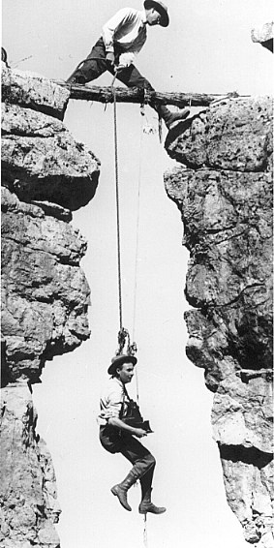
If I suspend, when can I reenroll?
“Suspend” retiree health insurance if you have other coverage.
You may re-enroll:
  Open Enrollment
  Involuntary loss of coverage

Slide 18


Do dental and vision continue?
Delta Dental
Continues with
UC contribution
Retiree Vision (VSP)
May elect to continue You pay premium

Slide 19

Dental
Delta PPO or DeltaCare USA
  Coverage remains the same
  Premium paid in full by UC
    OR subject to “graduated eligibility”
  Delta Dental PPO – Worldwide coverage
  DeltaCare USA – California only

Slide 20

Vision with VSP
Retiree Vision Services Plan (VSP)
  You pay full premium to VSP
  Coverage is similar to employee plan
  Routine eye exam and eyewear
  Worldwide coverage
  Rates on UCnet
  Optional

Slide 21

Plan Options

Slide 22
Types of Medical Plans
Non-Medicare Plans
  Retirees and family members who are
  not eligible for Medicare
Medicare “Coordinated” Plans
  Retirees or family members who are 65 or older, or disabled and eligible for Medicare
    1. Enroll in Medicare A & B
    2. Enroll in UC Medicare plan

Slide 23
Medical Plans
UC Non-Medicare
UC Blue & Gold HMO Kaiser HMO
UC Care (PPO) Health Savings Plan (PPO) Core (PPO)
UC Medicare
UC Medicare Choice Kaiser Senior Advantage HMO
UC Medicare PPO with Rx UC Medicare PPO w/o Rx High Option Supplement
Same as employee plans
Coordinated with Medicare

Slide 24
Transition to Medicare
Retiree and/or family members who are
eligible for Medicare change plans
Non Medicare
UC Medicare
UC Blue & Gold HMO
UC Medicare Choice
Kaiser HMO
Kaiser Senior Advantage
UC Care PPO
UC Medicare PPO
Core PPO
UC Medicare PPO
UC Health Savings is not available to split family

Slide 25

Behavioral Health
All medical plans cover mental health care and substance abuse treatment
Coverage and provider networks differ

Slide 26
Behavioral Health Providers
Non-Medicare plans are same as employee plans
Non-Medicare Plan | Behavioral Health
UC Blue & Gold HMO | MHN
Kaiser HMO | Optum & Kaiser
UC Care (PPO) Health Savings Plan Core | Anthem & non-Anthem

Slide 27
Behavioral Health Providers
Medicare plans are different
Medicare Plan | Behavioral Health
UC Medicare Choice | Any behavioral health provider
Kaiser Senior Advantage | Kaiser
Medicare PPO | Medicare Non-Medicare
High Option | Medicare Non-Medicare

Slide 28

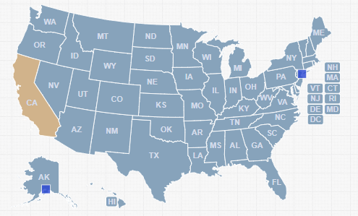
Moving? LIVING in the US
Must live in
CA Service Area
  UC Blue & Gold
  Kaiser
  UC Medicare Choice
Available in US
  UC Care
  Core
  Health Savings Plan
  Medicare PPO*
*split families

Slide 29
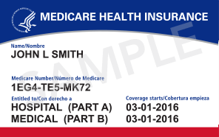
Moving? LIVING outside the US
  UC Care
  Core

Slide 30
Via Benefits – Out of CA
Living outside of California but in US
When all family members are eligible for Medicare
UC makes annual $3000 contribution to Health Reimbursement Account (HRA) for each member
  UC contribution is subject to graduated eligibility
Use HRA money to purchase individual Medicare supplement plan & Part D through Via Benefits.
  Use excess HRA money to pay medical expenses and Part B premium
  Unused HRA money will roll over to next year

Slide 31

Via Benefits – Enrollment
RASC sends monthly file feed to Via Benefits Via Benefits will then send regular communications to assist you from transferring from current UC medical plan to a local Medicare plan
You will be directed to call a Via Benefits counselor for information about plan options and assistance enrolling
You will select from Medicare Supplement plans and Part D (Drug) plans that are available where you are living

Slide 32

Eligibility & Costs

Slide 33
Retiree Health Premiums
Annually, UC determines the maximum contribution paid towards retiree medical and dental insurance.
  UC does not pay full retiree health insurance premium for medical
  Some retirees receive the maximum
  UC contribution
  Some retirees have graduated eligibility and receive a % of the maximum amount

Slide 34
Maximum UC Contribution
The maximum UC contributes towards retiree health insurance premiums. This contribution amount can change year to year.

Slide 35
Eligibility & Cost
Three retiree health insurance groups with different University of California Retirement Plan (UCRP) entry dates
Group 1
Entry prior to 1/1/1990
Group 2
Entry or reentry on or after 1/1/1990 to 6/30/2013
Group 3
Entry or reentry on or after 7/1/2013

Slide 36
Eligibility Group 1
Entry
Entry prior to 1/1/1990*
20 years
UCRP
Service Credit
100% UC Contribution
*No break in service

Slide 37
Eligibility Group 2
Entry
1/1/1990 to 6/30/2013*
20 years
UCRP
Service Credit
100% UC Contribution
*No break in service & subject to collective bargaining

Slide 38
Eligibility Group 2 cont’d
Entry
1/1/1990 to 6/30/2013* At least 10 years UCRP Service Credit
Age
+
Service
Credit
= 75
Graduated Eligibility
Receive % of UC Contribution
or
*No break in service & subject to collective bargaining

Slide 39
Eligibility Group 3
Entry
Entry or reentry on or after 7/1/2013 to Present
Minimum 10 years of service credit & retire at age 56
UC Contribution can range between 0%-100% calculated using age and service credit
100% UC Contribution at age 65 w/ 20 years of service credit

Slide 40
Where do I find rates?
Eligible for Maximum UC Contribution
Find premiums under Retiree Medical Plan Costs (2020) on UCnet
Contact RASC via UCRAYS
Graduated Eligibility
Retiree Health & Welfare Benefits page UCnet
Retirement Handbook on UCnet
Contact RASC via UCRAYS
*Premiums change when you or a family member enroll in Medicare*

Slide 41
Rate Chart - Maximum UC Contribution
All family members in Medicare
One or more are not in Medicare
Non-Medicare Plans
  All family members under age 65
Non-Medicare Age 65 and Over
  UC Retiree did not coordinate with Social Security when employed
  No one in family eligible for Medicare

Slide 42
Your Monthly Costs
Medicare Part B Premiums
  $144.60 per person – standard rate in 2020
  Deducted from Social Security check
  or you pay directly to Social Security
UC Medical and Dental Premiums
  Deducted from UC pension check
  Part B Reimbursement added to check
UC Retiree Vision – You pay to VSP

Slide 43
“Income Related Adjustment”
Medicare Part B and D premiums may be higher for retirees with incomes over:
  $87,000 – single
  $174,000 – married
  Rules for Higher Income Beneficiaries
  https://www.ssa.gov/pubs/EN-05-10536.pdf

Slide 44
Premium breakdown
Medicare Part B premium (& Part D if you have higher income)
+
UC retiree health insurance premium
+
Dental (graduated eligibility)
+
Vision (optional)
+
Legal (optional)

Slide 45

Medicare

Slide 46

Who is eligible for Medicare?
Your own work history
Work history of spouse or ex-spouse
Contact Social Security to clarify your eligibility

Slide 47
What is Medicare?
Federal program that provides medical insurance to:
  People 65 or older
  People with disabilities
Covers most medical services
Does not pay total cost of care

Slide 48


Three Parts of Medicare
Part A - Hospital
Part B - Medical
In-patient hospital
Home health care
Skilled nursing facility
Hospice care
Doctors
Lab tests
Physical therapy
Preventive care

Slide 49

Three Parts of Medicare cont’d
Part D – Prescription Drugs
UC bundles Part D coverage with the UC medical plan

Slide 50
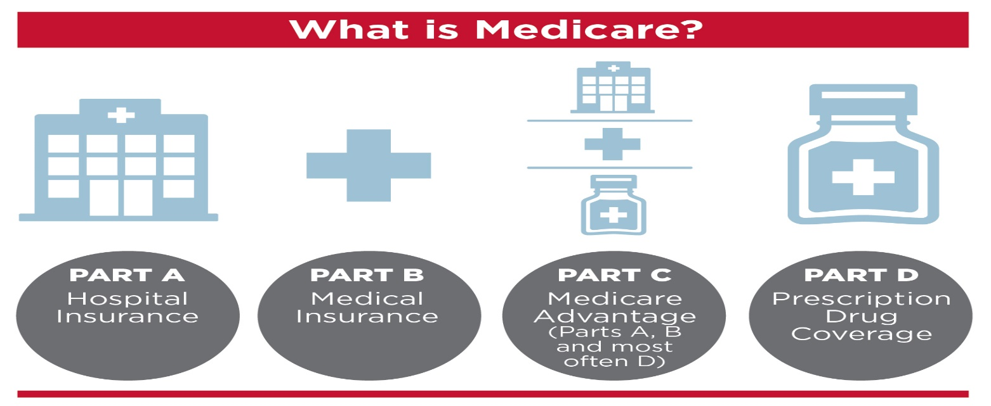
What is Medicare?
UC Medicare Choice (PPO)
Kaiser (HMO)

Slide 51
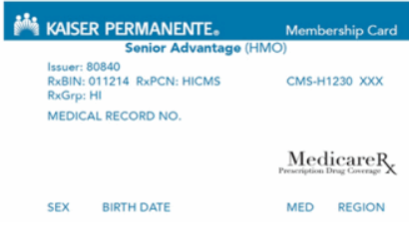
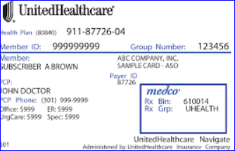
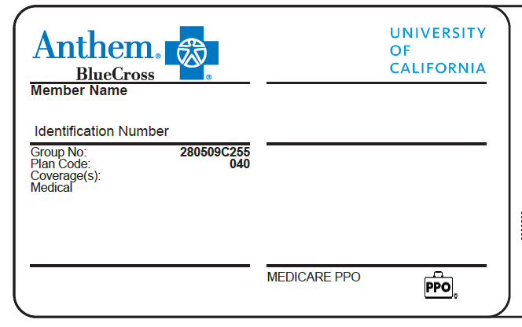
Medicare & UC Work Together
Medicare and UC plan
pay most of your medical expenses
Medicare A, B & D
UC Medicare Plans

Slide 52
Medicare Premiums in 2020
Medicare Part A - No monthly premium
Medicare Part B - $144.60 per month
  May cost more for retirees with higher income
  Deducted from Social Security check
  or you pay directly
Medicare Part D - No monthly premium
  Unless you have a higher income (you pay higher Part B premium and a Part D premium)

Slide 53


UC Medicare Advantage Plans
Assign your Medicare to the insurance plan
Provider bills insurance directly
Referrals not required
PPO Advantage (Part C)
UC Medicare Choice
HMO Advantage (Part C)
Kaiser Senior Advantage
Assign your Medicare to the insurance plan
Provider bills insurance directly
PCP/Referrals required

Slide 54
Choice of Physician
HMO Advantage
Kaiser Senior Advantage
You select PCP
PCP coordinates care
PCP refers to specialists
Specialists limited to medical group

Slide 55
Choice of Physician
PPO Advantage
UC Medicare Choice
Do not need PCP
Do not need referrals for specialist
May use UHC or Medicare doctors who accept Medicare assignment and willing to bill UHC

Slide 56
Cost of Care
UC Medicare Choice
Kaiser Senior Advantage
Service | Copay
Deductible | $0
Office Visit | $20
Urgent Care | $20
Emergency Room | $65
Outpatient Surgical Center | $100
Inpatient Hospital | $250

Slide 57

UC Medicare Supplement Plans
UC Medicare PPO
UC Medicare PPO w/o Rx
High Option
Medicare is primary
Anthem is secondary
Provider bills Medicare, Medicare coordinates with Anthem

Slide 58
Supplements & Medicare Crossover
Medicare Crossover allows Medicare to electronically transfer claims to Anthem Blue Cross for secondary payment
You may receive a questionnaire from
Anthem Blue Cross if they need additional information
  Call the number on the form – easier than trying to answer questions in writing

Slide 59
Choice of Physician
UC Medicare PPO & (w/o Rx)
High Option
Medicare is primary insurance so you must use Medicare doctors for Medicare services. Search Medicare doctors on Medicare.gov website
Anthem or non Anthem
doctors for “additional services”
  acupuncture
  hearing aids
  expenses outside US
  behavioral health
  *Additional services are not covered by Medicare but are covered by Anthem

Slide 60
Supplement Deductibles
Anthem pays:
  Medicare Part A & B deductibles
You pay:
  UC Medicare PPO = $100 per individual/year
  High Option = $50 per individual/year
  Plan deductible for services not covered by Medicare (e.g. acupuncture, hearing aids,
  expenses outside US, some behavioral health)

Slide 61
Supplements – Office Visit Example
Medicare Allowable = $150
Who pays?
Medicare pays 80%
Anthem pays
You pay
PPO
$120
$24 (80%)
$6
High Option
$120
$30 (100%)
$0
Primary
Secondary
Medicare PPO – Anthem Pays 80%
High Option – Anthem Pays 100%
Notes:
Medicare allowable is $150 – Medicare pays 80% $120 ($150-$120= $30) Anthem pays 80%= $24 ($30-$24)= $6

Slide 62
Supplements – Hospital Example
Stay of 1-60 days
2020 Medicare Part A Deductible = $1,408
Who pays?
Anthem pays
You pay
PPO
$1,408
$0
High Option
$1,408
$0
Medicare pays balance of bill

Slide 63
Supplements – Skilled Nursing
1st to 21st day: Paid in full by Medicare
21st to 100th day: Daily rate = $176
Who pays for 21st – 100th day?
Anthem pays
You pay
PPO
80% $176
$35.20/day
High Option
100% $176
$0
Medicare pays all but $176 per day

Slide 64
Are you traveling out of US?
Kaiser Senior Adv. | ER & Urgent Care Only
UC Medicare Choice | ER/Urgent/Routine Care Copays
UC Medicare PPO | $100 deductible per year 20% of billed amount
High Option | $50 deductible per year 20% of billed amount

Slide 65
Prescription Drugs - Part D
All Medicare plans have Part D with the
exception of Medicare PPO without Rx
NO additional premium for Part D, for most
Copays
Some formulary (drug list) changes

Slide 66
Part D – Drug Copays
 | UC Medicare Choice | Medicare PPO High Option
Retail (30 day) Generic Brand Non-formulary | $5 $25 $40 | $10 $30 $45
Mail Order (90 day) Generic Brand Non-formulary | $10 $50 $80 | $20 $60 $90
*Kaiser Senior Advantage rates vary slightly- Retail (30 day supply) $5 generic, $25 brand. See plan documents for additional Rx costs.

Slide 67
ID Cards
- Everyone receives a Medicare card
- UC Medicare Choice & Kaiser members:
1 card (medical & Rx on same card)
Give provider your UC Medicare Choice/Kaiser ID card only
- Anthem PPO members:
2 cards (1 card for medical & 1 card for Rx)
Give provider your Medicare card first and Anthem card second

Slide 68
Medicare PPO without Rx
Medicare allows one Part D (Drug) plan
Retirees enrolled in a non-UC Part D
may enroll in the Medicare PPO without Rx
Medical coverage will be provided by Medicare and Anthem
Drug coverage will be provided by the retiree’s non-UC insurance

Slide 69
Out-of-Pocket Maximums
After an individual pays the following amount for medical services or prescriptions drugs, the plan pays 100% of the costs for the rest of the year.
Medicare Plan | Medical | Drug
UC Medicare Choice | $1,500 | $6,350
Kaiser Senior Advantage | $1,500 | $6,350
UC Medicare PPO with Rx | $1,500 | $6,350
UC Medicare PPO w/o Rx | $1,500 | NA
High Option | $1,050 | $6,350

Slide 70
When to enroll in Medicare?
Employees - Still Working
Retiring - At retirement
Retired - After retirement

Slide 71
Employees
Do not enroll in Medicare Part B or D
Spouse enrolled in your UC employee medical plan does not need to enroll
“Special enrollment period” when UC employee retires
You may enroll in Part A when first eligible at age 65 – not required *
* Special considerations for
Health Savings Plan and Domestic Partners

Slide 72
Employees – Special Considerations
Health Savings Plan
Delay enrollment in Medicare A, B & D until retirement
Please note: If you are drawing a Social Security pension, you will automatically be enrolled in
Part A at age 65 – you can’t contribute to HSA.

Slide 73
Employees – Special Considerations
Domestic Partners
At age 65 consult Social Security about when to apply for Medicare
You may or may not have a “special enrollment period” while enrolled in employee plan

Slide 74

Eligible at Retirement
Apply for Medicare Part A & B
Enroll online or call Social Security office
two month before UC employee retires
RASC counselor will send you forms
  SSA form:
  Request for Employment Information
  UC form:
  Medicare Advantage Universal Enrollment Form
  Medicare Rx PDP Enrollment Form

Slide 75
Eligible at Retirement-Process
You apply for Medicare
A & B
with SSA
SSA confirms enrollment on your SSA account
You send
UC form
to RASC
RASC & Insurance update your plan
Insurance enrolls you in
Part D
Insurance sends you new
ID card
You inform providers of
new plan

Slide 76
Eligible after Retirement
Apply for Medicare Parts A & B
  Go to Social Security office or www.ssa.gov about three months before turning 65
  OR
  If receiving a Social Security pension, you will get a Medicare card in the mail
RASC will mail you and family members
UC forms to enroll in the UC Medicare plan

Slide 77
Eligible after Retirement-Process
You apply for Medicare
A & B
with SSA
SSA confirms enrollment on your SSA account
You send
UC form
to RASC
RASC & Insurance update your plan
Insurance enrolls you in
Part D
Insurance sends you new
ID card
You inform providers of
new plan

Slide 78
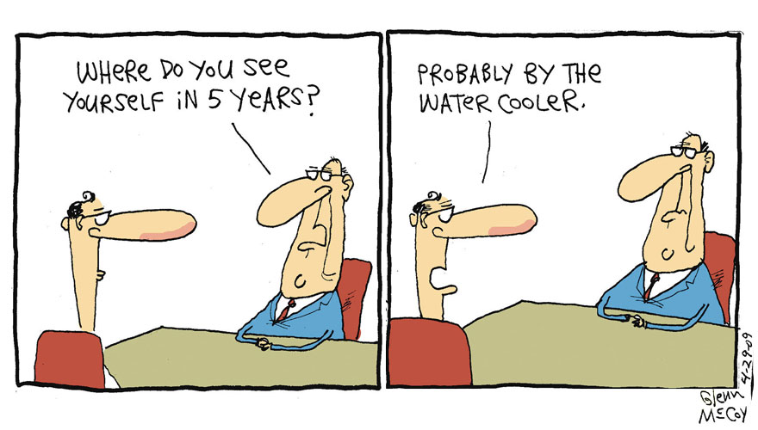
Want to come back???
Returning to work can impact how your medical plan coordinates with Medicare
Review the Returning to UC Employment after Retirement factsheet

Slide 79
Web Resources
https://retirementatyourservice.ucop.edu/ -UCRAYS
http://ucnet.universityofcalifornia.edu -UCnet
Complete Guide to Retirement Benefits
Retirement Handbook
http://www.ssa.gov -Social Security Admin
Apply for Medicare Benefits
http://www.medicare.gov -Medicare
Original Medicare coverage and publications
“Your Medicare Benefits” booklet

Slide 80
Medicare Forms for RASC
Kaiser HMO→Kaiser Senior Advantage
UBEN 127
UC Blue & Gold HMO→UC Medicare Choice
UBEN 121
UC Care/HSP/Core→UC Medicare PPO
UBEN 123
Forms available on UCnet

Slide 81
Resources
UC Retirement At Your Service (UCRAYS)
  Register with UCRAYS via UCnet
  Submit retirement forms via secure email or
  Ph#: 1-800-888-8267
  Fax#: 1-800-792-5178
Health Care Facilitator- Rebecca Preza
  Retiree health insurance questions
  Medicare Coordination
  rebecca.preza@hr.ucsb.edu

Slide 82

Questions

